Slide 1


ChRIS Virtualization Project
By Henry Mayper, Jaewoo Chung, Michael Hajjar, Huynh Tran, Justin Victoria
Guidance and Mentorship: Rudolph Pienaar
PhD Researcher Boston Children’s Hospital

Slide 2
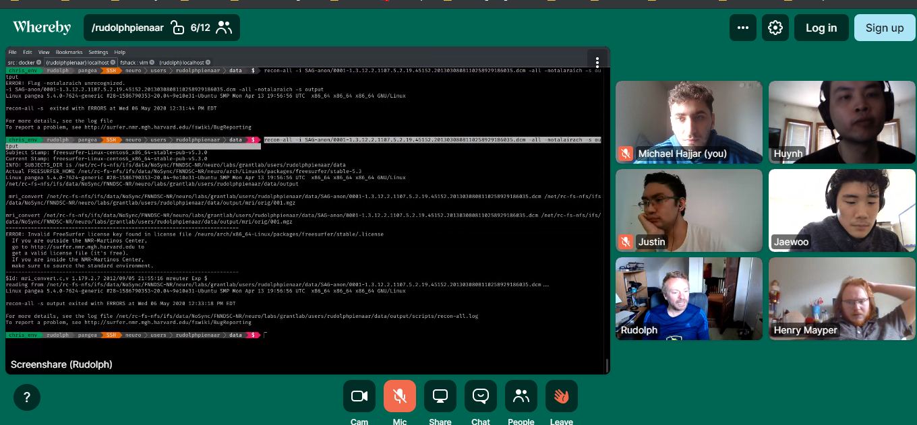
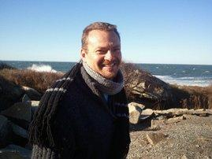


Slide 3
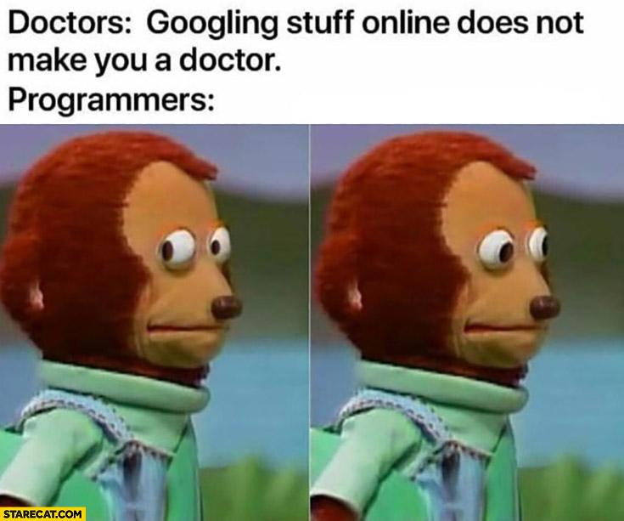

We’re Programmers, not MRI Technicians

Slide 4
Project Overview
“Doctors cannot be expected to fire up a Linux terminal or use command lines to extract useful data.”
The ChRIS (ChRIS Research Integration System) platform was designed to help medical professionals use computational medicine in as user-friendly a way as possible.
This project is about creating a plugin that will fit into the ChRIS system and running a complicated tool in a container.
This also provides more data that doctors and physicians can pull from rather than giving a “ballpark” diagnosis.
Ultimately, to drive medical innovation.

Slide 5

Initial Plan and Ideas
Deploy technology onto a Docker container.
Maybe we work on some kind of User Interface
Revisioning and getting Freesurfer to run
Use a cookie-cutter?
Learn the environment on the titan server
Explore cookie cutter and all it's commands

Slide 6

Challenges! 28 Days Later
Project Proposal, did not have an adept understanding to get a good grade on the proposal.
Everyone having a full running program on their local machines
COVID-19, disrupted our multiple weekly meetings, had to switch to discord for communications and Whereby for video conferencing as well as slack for contacting Dr. Pienaar
Setting up the environment was difficult
Everyone attempting to do the project their own way

Slide 7

How we solved our challenges
Worked Harder!
Put more time into the project
Used online communications platform to keep each other up to date
Conducted more online research and explored useful tutorials

Slide 8
Live Show Action
Our Live action presentation of how our project runs

Slide 9
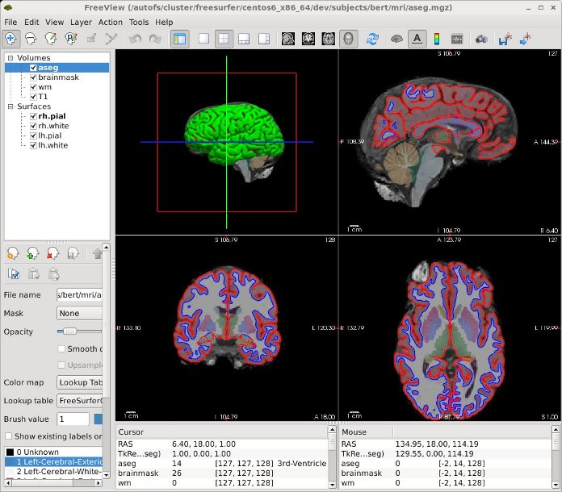

Slide 10
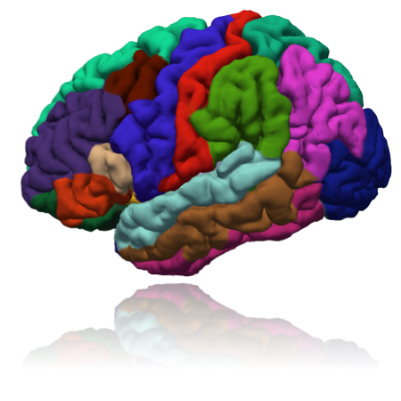

Technology Used
In order to run this project, Linux was required whether it was run natively or on a virtual machine.
FreeSurfer (Brain Imaging Software) that is obtained from the Harvard Educational website, must apply for license to run freely
Docker, which gives us an O.S. level virtualization to deliver the software within a container
Pl-fshack, a ChRIS app based platform that houses the complete FreeSurfer Install and runs it via a plugin
Python! High level general purpose programming language

Slide 11

Shipping and Handling
Installing Freesurfer from within the Docker container required running a setup script that sets up environment variables. These environment variables would disappear upon building the image.
Instead, we pre-set the environment variables and got them to persist after Docker runs.

Slide 12

Lessons Learned
How to use Docker
Better understanding of Linux
Using Linux over Windows is preferred.
https://slides.com/haehn/cs410_lecture22#/12/0/1
With Linux, there’s much less overhead!
"Never a failure, always a lesson"

Slide 13

Where Do Would We Go From Here?
Update the Github Readme file for people who would like to learn more about running this who don't have experience and are new to this technology
Initially, we used freesurfer version 6, but switched it to the more recent version 7
Latest version will be used in maintenance despite slight sacrifice in stability (small errors msgs, but program still works! That’s okay, right?)

Slide 14

Thank You! Any Questions?
: )

